Slide 1
PRT– S401 B.TECH PROJECT Sign Language Recognition Using Machine Learning .
Under Supervision of
Er. Suruchi Singh
(Assistant Prof.)
Dept. of computer science
and Engineering,
UIET, CSJMU
Presented By: GROUP-1
Roll No | Name .
004 | Adarsh Kr. Nishad
007 | Aishwary Bajpai
050 | Shubham Yadav
CSE (2K18) Final Year

Slide 2
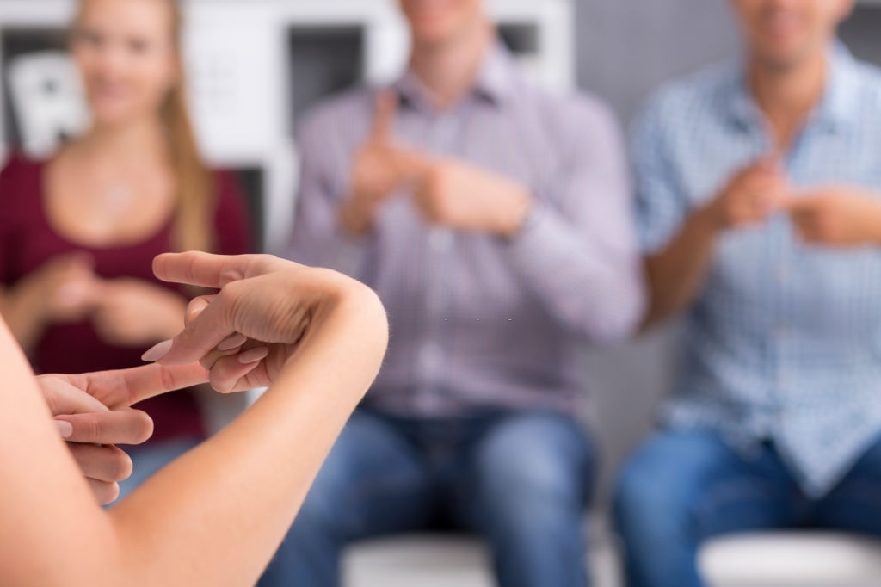
Sign Language Recognition Using Machine Learning

Slide 3
TABLE OF CONTENTS
01
02
03
Project Structure
Data Processing
Training & Saving Modal
04
05
Website(front end) Demo
Classifying Gesture on Front-End

Slide 4
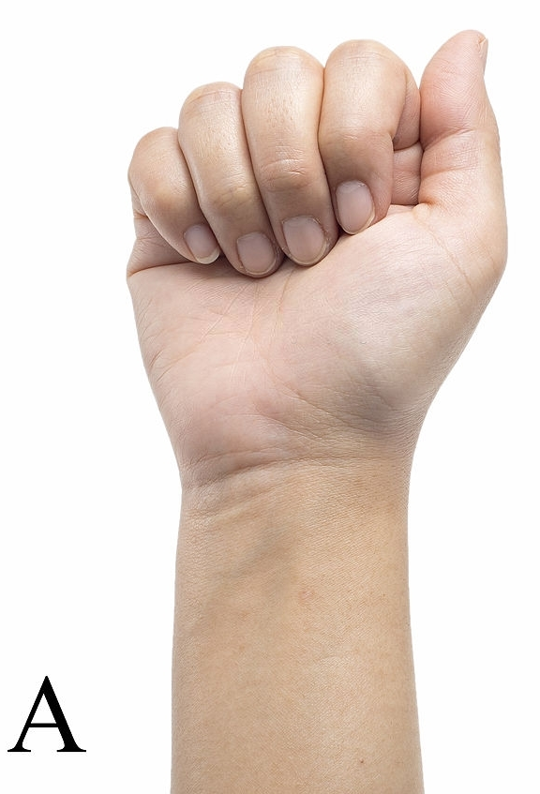
Introduction
Our project aims to create a computer application and train a model.
It shows a real time hand gestures of American Sign Language.
The output for that particular sign in text format on the screen.
The Project predict gesture of American Sign Language (ASL).
It is purely based on hand gesture.

Slide 5
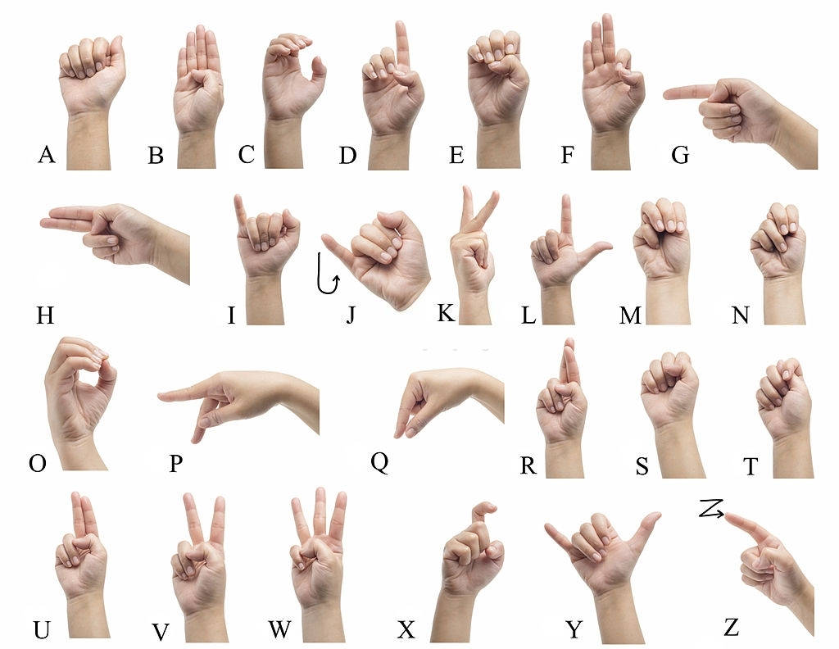
ASL Gestures
Image Source : Google

Slide 6
Tools Used
Library Used For Machine Learning Model
Python 3
OpenCV 3
Tensorflow
Keras
For Web Page Development
Html
CSS
Bootstrap
Flask
Ide Used For Development
Anaconda
VS Code

Slide 7
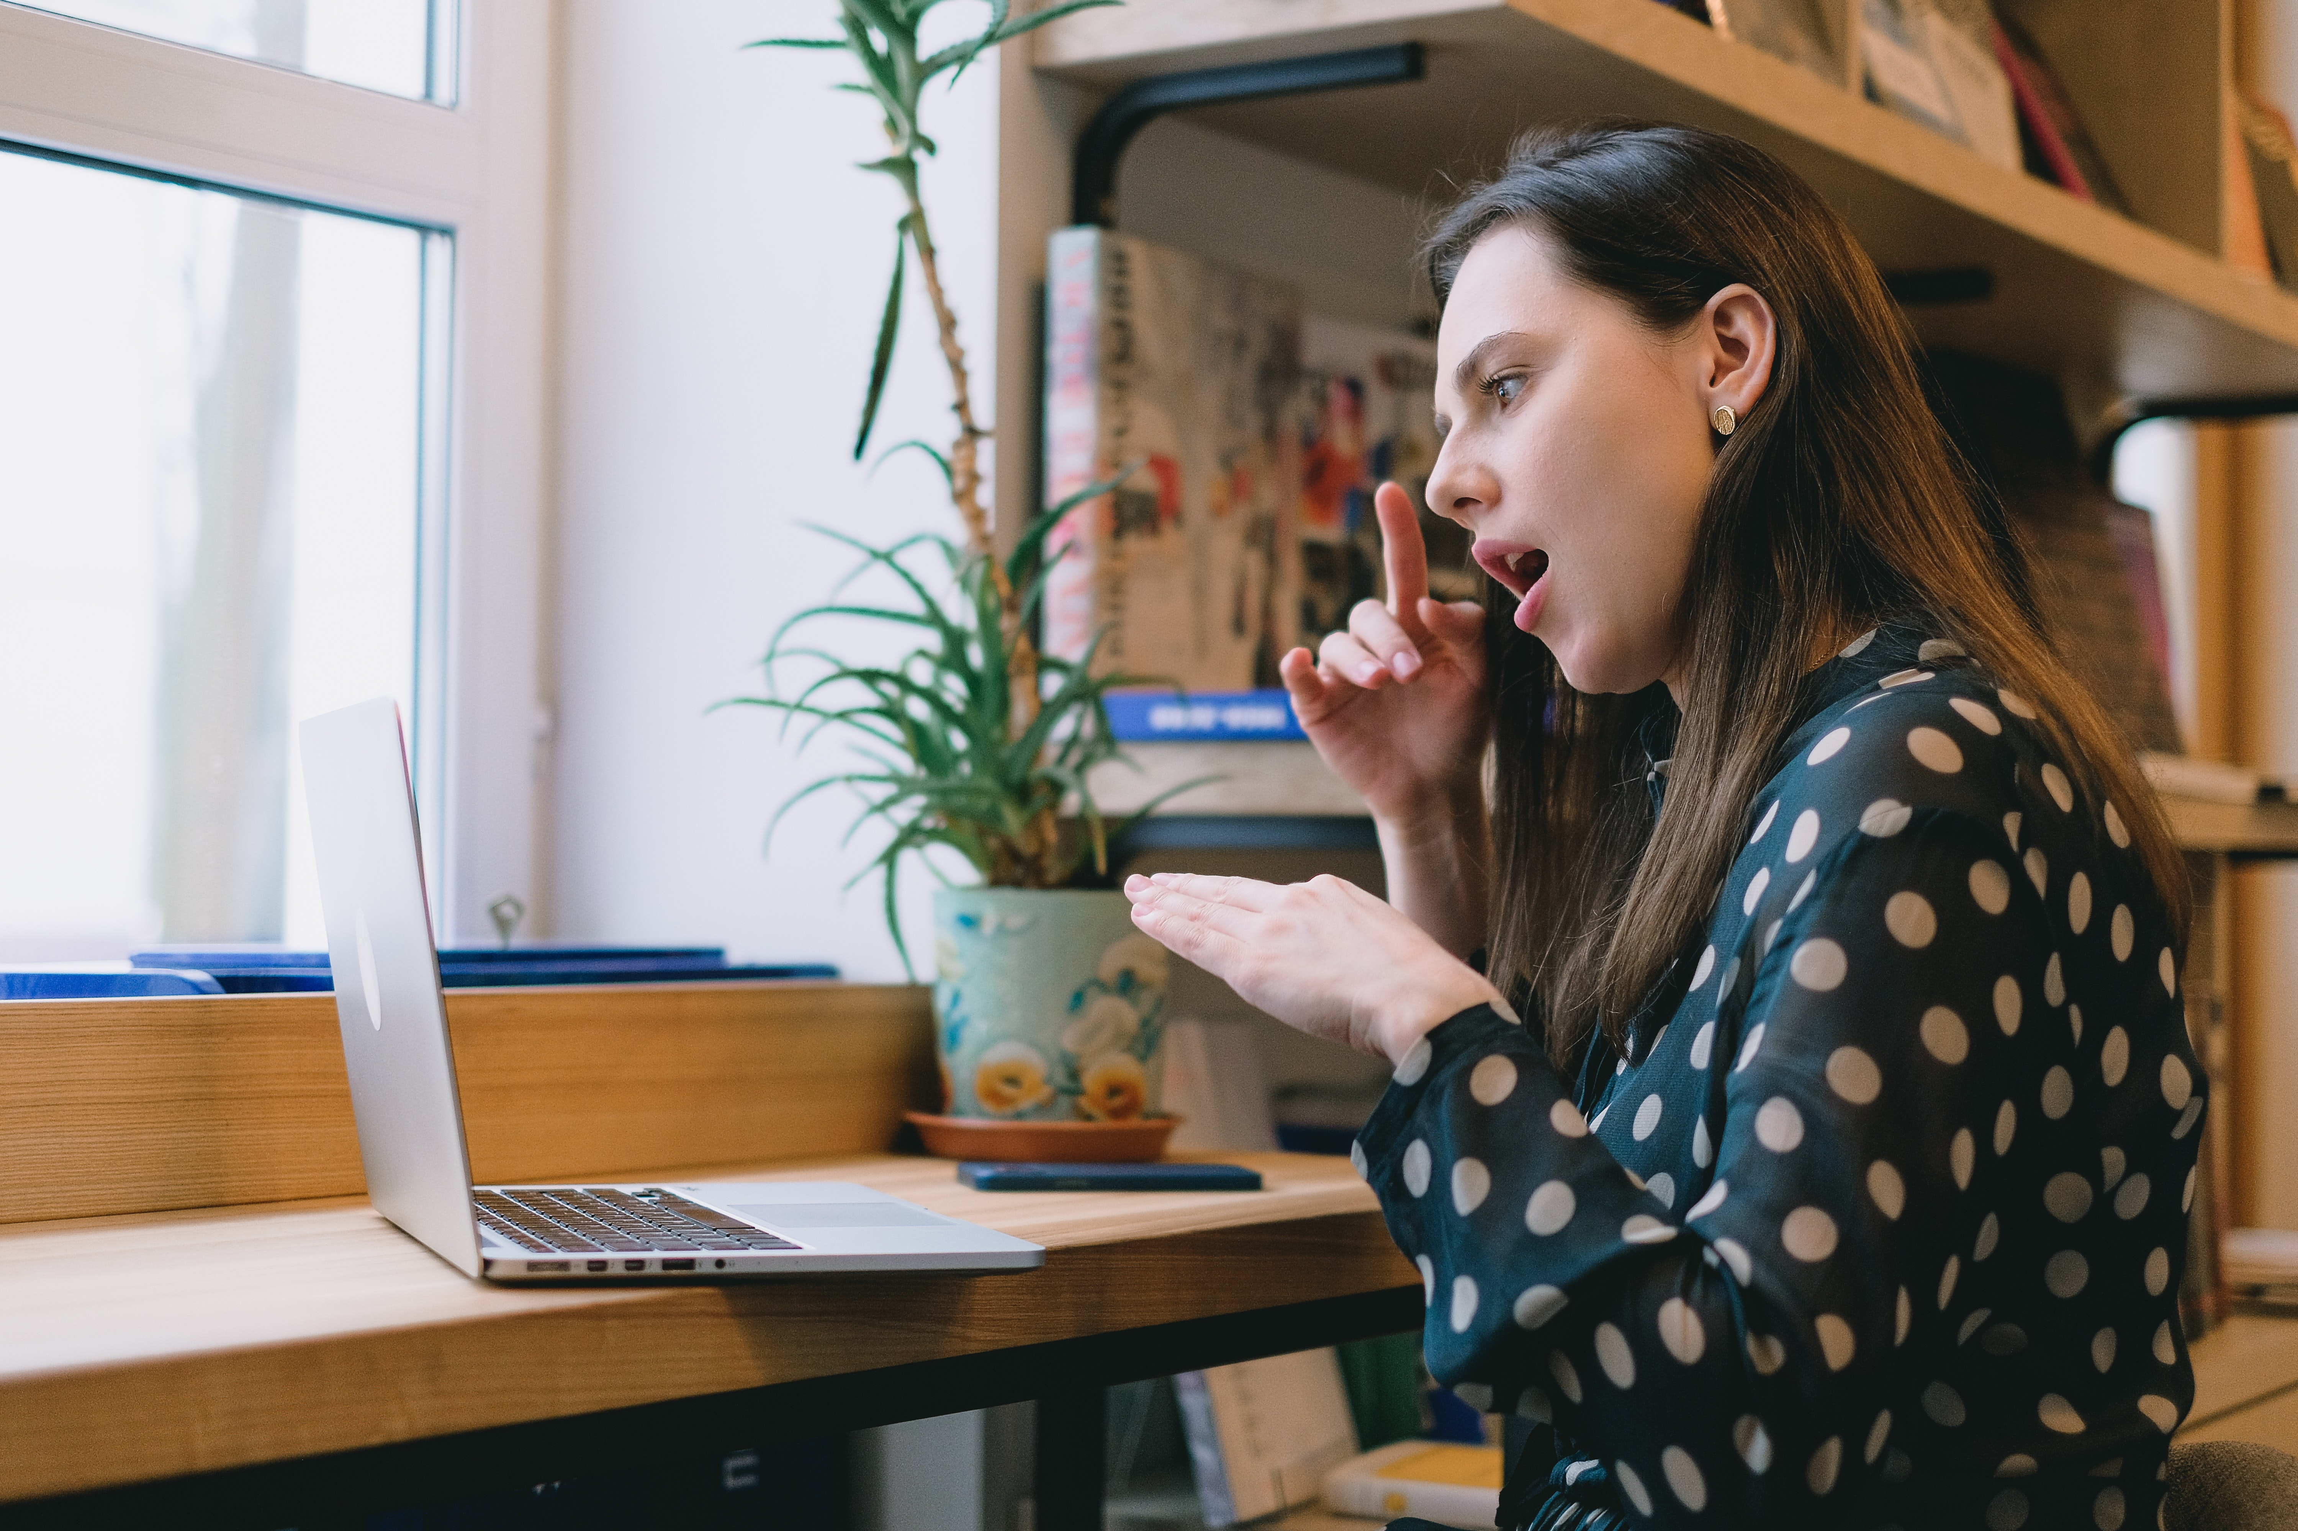
01
Project Structure

Slide 8
Overall Structure of Project

Slide 9
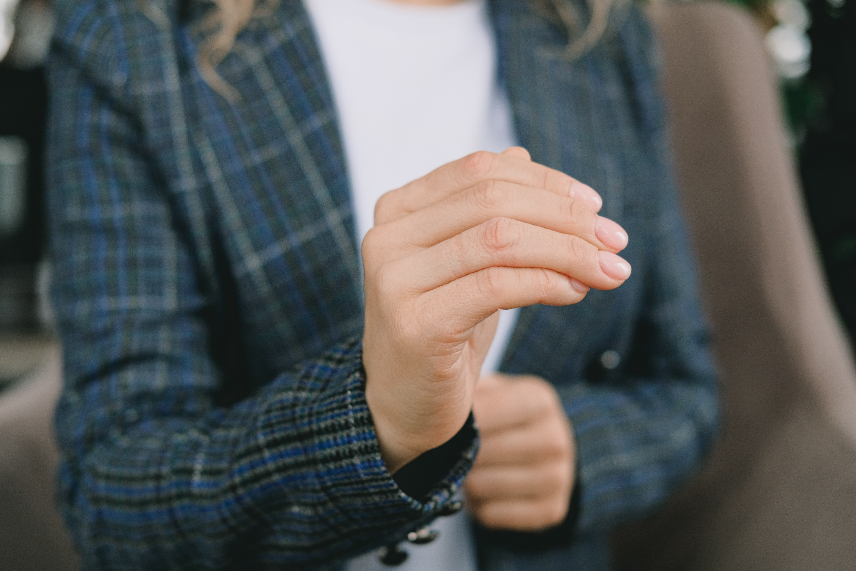
02
Data Processing

Slide 10
Data Collecting And Processing
To create our own Dataset we have a dedicated program which Capture image from webcam.
There is a rectangle frame in test frame to capture desired portion of image.
We Use HSV color model to enhance our images capture from web cam
We include HSV color trackbar to adjust the color .
Images captures from webcam is masked for training purpose.
Total Image For
Training->26*1750=45500
Testing->26*250=6500

Slide 11
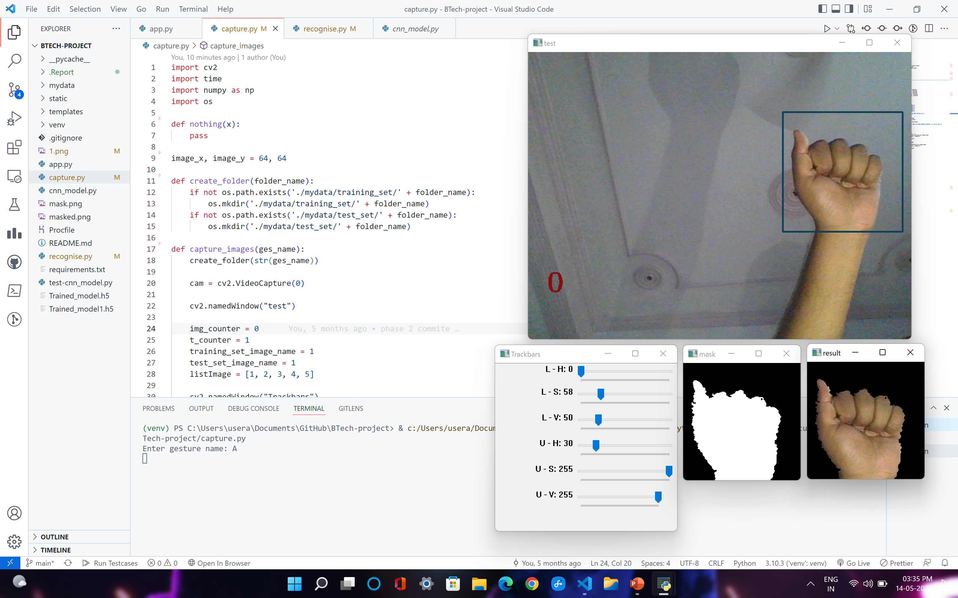
Data Collecting And Processing
Crop
Apply HSV To create mask
Croped Image
HSV Trackbars
Original Image
Apply Mask to Croped Image
Masked Image
Mask

Slide 12
Capture.py
CNN_modal.py
import cv2
import time
import numpy as np
import os
def nothing(x):
pass
image_x, image_y = 64, 64
def create_folder(folder_name):
if not os.path.exists('./mydata/training_set/' + folder_name):
os.mkdir('./mydata/training_set/' + folder_name)
if not os.path.exists('./mydata/test_set/' + folder_name):
os.mkdir('./mydata/test_set/' + folder_name)
def capture_images(ges_name):
create_folder(str(ges_name))
cam = cv2.VideoCapture(0) cv2.namedWindow("test")
img_counter = 0
t_counter = 1
training_set_image_name = 1
test_set_image_name = 1
listImage = [1, 2, 3, 4, 5] cv2.namedWindow("Trackbars")
Python

Slide 13
Capture.py
CNN_modal.py
cv2.createTrackbar("L - H", "Trackbars", 0, 179, nothing)
cv2.createTrackbar("L - S", "Trackbars", 58, 255, nothing)
cv2.createTrackbar("L - V", "Trackbars", 50, 255, nothing)
cv2.createTrackbar("U - H", "Trackbars", 30, 179, nothing)
cv2.createTrackbar("U - S", "Trackbars", 255, 255, nothing)
cv2.createTrackbar("U - V", "Trackbars", 255, 255, nothing)
for loop in listImage:
while True: ret, frame = cam.read()
frame = cv2.flip(frame, 1) l_h = cv2.getTrackbarPos("L - H", "Trackbars")
l_s = cv2.getTrackbarPos("L - S", "Trackbars")
l_v = cv2.getTrackbarPos("L - V", "Trackbars")
u_h = cv2.getTrackbarPos("U - H", "Trackbars")
u_s = cv2.getTrackbarPos("U - S", "Trackbars")
u_v = cv2.getTrackbarPos("U - V", "Trackbars")
img = cv2.rectangle(frame, (425, 100), (625,300),(88,65,15),2)
lower_blue = np.array([l_h, l_s, l_v])
upper_blue = np.array([u_h, u_s, u_v])
imcrop = img[102:298, 427:623]
hsv = cv2.cvtColor(imcrop, cv2.COLOR_BGR2HSV)
mask = cv2.inRange(hsv, lower_blue, upper_blue)
result = cv2.bitwise_and(imcrop, imcrop, mask=mask) cv2.putText(frame, str(img_counter), (30, 400),cv2.FONT_HERSHEY_TRIPLEX, 1.5,(14,14,135),2)
cv2.imshow("test", frame)
cv2.imshow("mask", mask)
cv2.imshow("result", result)
ges_name = input("Enter gesture name: ")
capture_images(ges_name)
Python

Slide 14
Dataset Capturing

Slide 15
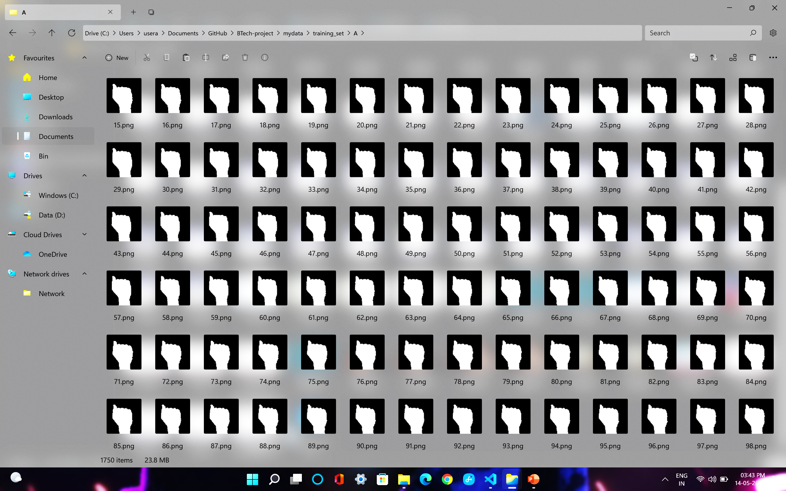
Dataset (Dataset Source : Kaggle)

Slide 16
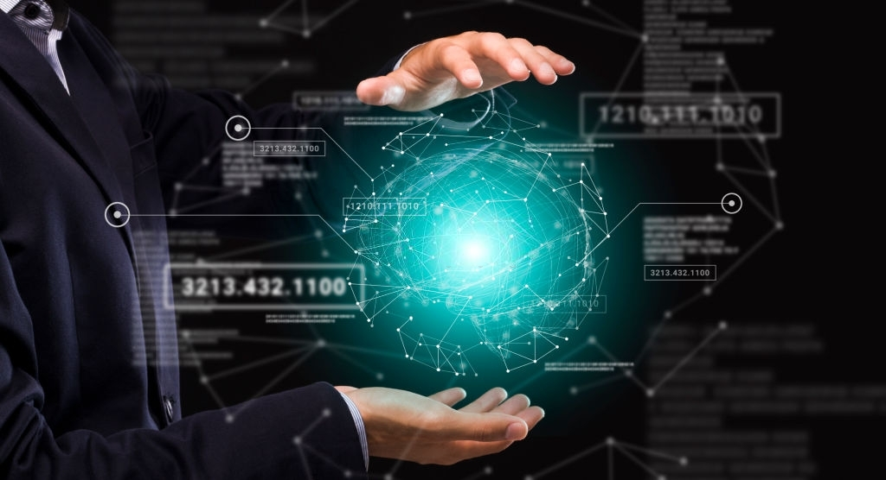
03
Training & Saving Modal

Slide 17
Block Model
64X64X3
32@3X3
CONVOLUTION
OUTPUT
62X62X32
MAX POOLING
2X2
31X31X32
FULLY CONNECTED LAYER
CONVOLUTION
1152
29X29X32
FLATTEN
MAX POOLING
12X12X32
14X14X32
6x6X326
MAX POOLING
CONVOLUTION

Slide 18
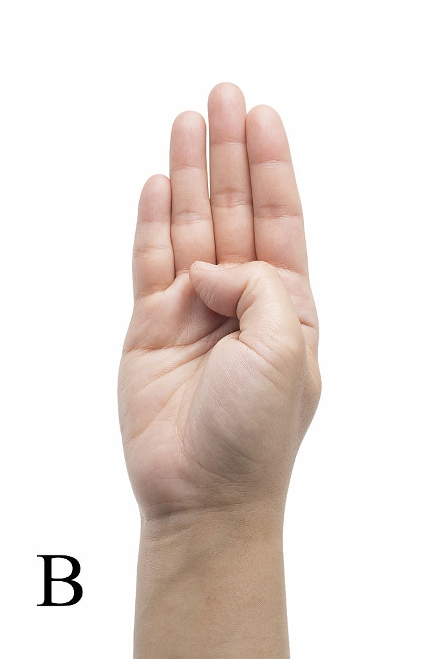
Training CNN Modal
A Convolutional Neural Network (CNN) is a Deep Learning algorithm which can take in an input image, assign importance (learnable weights and biases) to various aspects/objects in the image and be able to differentiate one from the other.
CNN MODEL LAYER 1
After converting RGB image into HSV followed by masking is given as input to the first layer.
This processed image when passed to the first layer it detects the edges in the image.
All Cnn models first layers works on detecting the edges in the image.
Layer also known as Edge detection layer.

Slide 19
Training CNN Modal
CNN MODEL LAYER 2
Output of Layer 1 is applied to this layer .
This layer is a composition of convolution and Max pooling.
The purpose of this layer is to learn all the features, shapes of the particular symbol and recognize the 26 symbols separately.

Slide 20
Training CNN Modal
CNN MODEL LAYER 3
We detect that upto layer 2 the output is not able to classify the symbol having almost similar hand signs.eg- (M,N,T) .hence, model upto layer 2 end up giving us low accuracy on testing data.
The significance of this layer is to increase the testing accuracy by classifying the symbols which have almost similar hand signs.
This layer also contains convolutional layer followed by max pooling layer so the output from layer 3 will have less parameters to feed in to the fully connected layer.

Slide 21
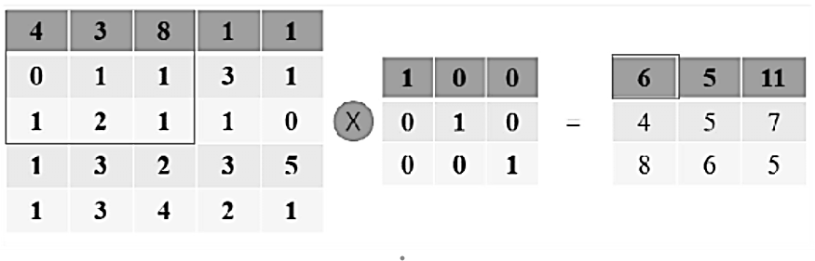
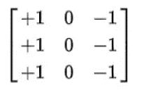
Convolutional operation
Convolution operation is used in convolution layer with different filters .eg – prewitt operator for edge detection. Eg – for vertical edge detection following filter is used
Image Source : Google
Image Source : Google

Slide 22
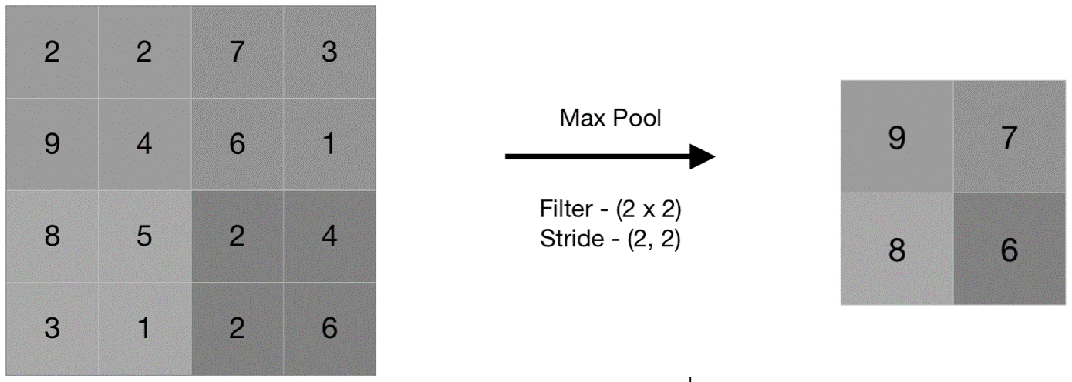
Max pooling
Image Source : Google

Slide 23
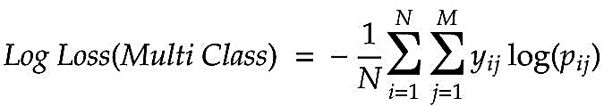
Loss Function
Log loss function for multiclass classification
Where, N is number if datapoints
j represents the value of jth label for ith data points
pij represents the value obtained for jth label for ith image by forward propagation.
yij represents the actual label value for the jth label for ith image.

Slide 24
CNN_modal.py
App.py
import pandas as pd
import matplotlib.pyplot as plt
import h5py
from keras.preprocessing.image import ImageDataGenerator
from keras.models import Sequential
from keras.layers import Convolution2D as Conv2D
from keras.layers import MaxPooling2D
from keras.layers import Flatten
from keras.layers import Dense, Dropout
from keras import optimizers
import os
os.environ['TF_CPP_MIN_LOG_LEVEL'] = '2'
# Initialing the CNN
classifier = Sequential()
# Adding 1st Convolutio Layer
classifier.add(Conv2D(32, (3, 3), input_shape=(64, 64, 3), activation='relu'))
# Pooling
classifier.add(MaxPooling2D(pool_size=(2, 2)))
# Adding 2nd convolution layer
classifier.add(Conv2D(32,( 3, 3), activation='relu'))
classifier.add(MaxPooling2D(pool_size=(2, 2)))
# Adding 3rd Concolution Layer
classifier.add(Conv2D(32, (3, 3), activation='relu'))
classifier.add(MaxPooling2D(pool_size=(2, 2)))
Python

Slide 25
CNN_modal.py
App.py
# Step 3 - Flattening
classifier.add(Flatten())
# Step 4 - Full Connection
classifier.add(Dense(256, activation='relu'))
classifier.add(Dropout(0.5))
classifier.add(Dense(26, activation='softmax'))
# Compiling The CNN
classifier.compile(optimizer='adam',loss='categorical_crossentropy',metrics=['accuracy'])
# Part 2 Fittting the CNN to the image
train_datagen = ImageDataGenerator(rescale=1./255,shear_range=0.2,zoom_range=0.2,
horizontal_flip=True)
test_datagen = ImageDataGenerator(rescale=1./255)
training_set = train_datagen.flow_from_directory('mydata/training_set',target_size=(64, 64),
batch_size=32,class_mode='categorical')
test_set = test_datagen.flow_from_directory('mydata/test_set',target_size=(64, 64),batch_size=32
,class_mode='categorical’)
history = classifier.fit_generator(training_set,steps_per_epoch=1422,
epochs=15,validation_data=test_set,validation_steps=204)
# Saving the model
classifier.save('Trained_model.h5')
#plotting graph
pd.DataFrame(history.history).plot(figsize = (8,5))
plt.grid(True)
plt.gca().set_ylim(0,1)
plt.show()
Python

Slide 26
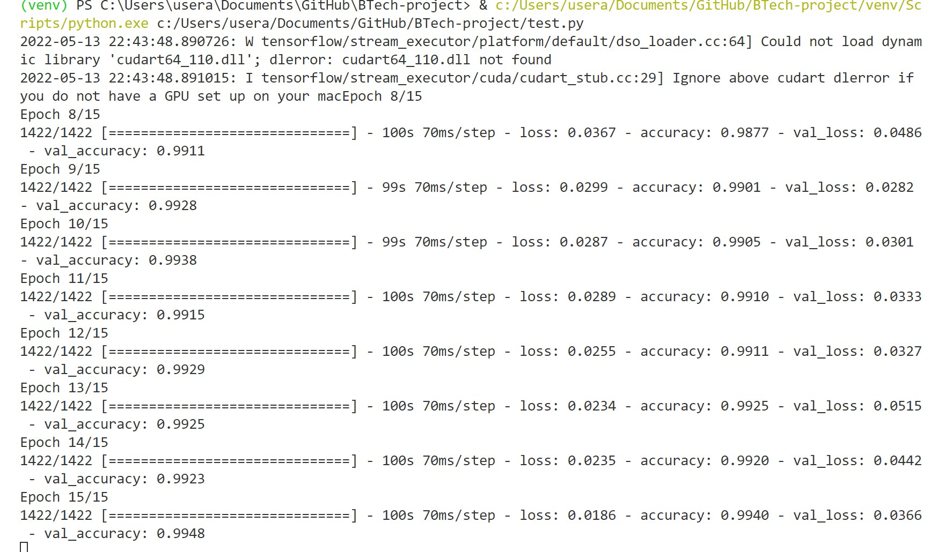
Training & Saving CNN Modal

Slide 27
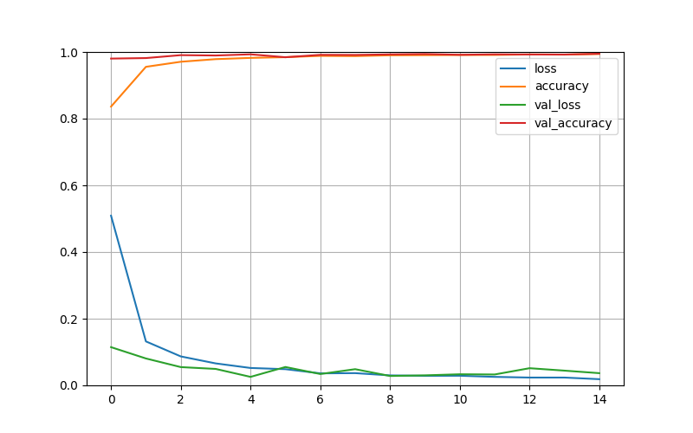
Modal Validation Accuracy & Loss Graph

Slide 28
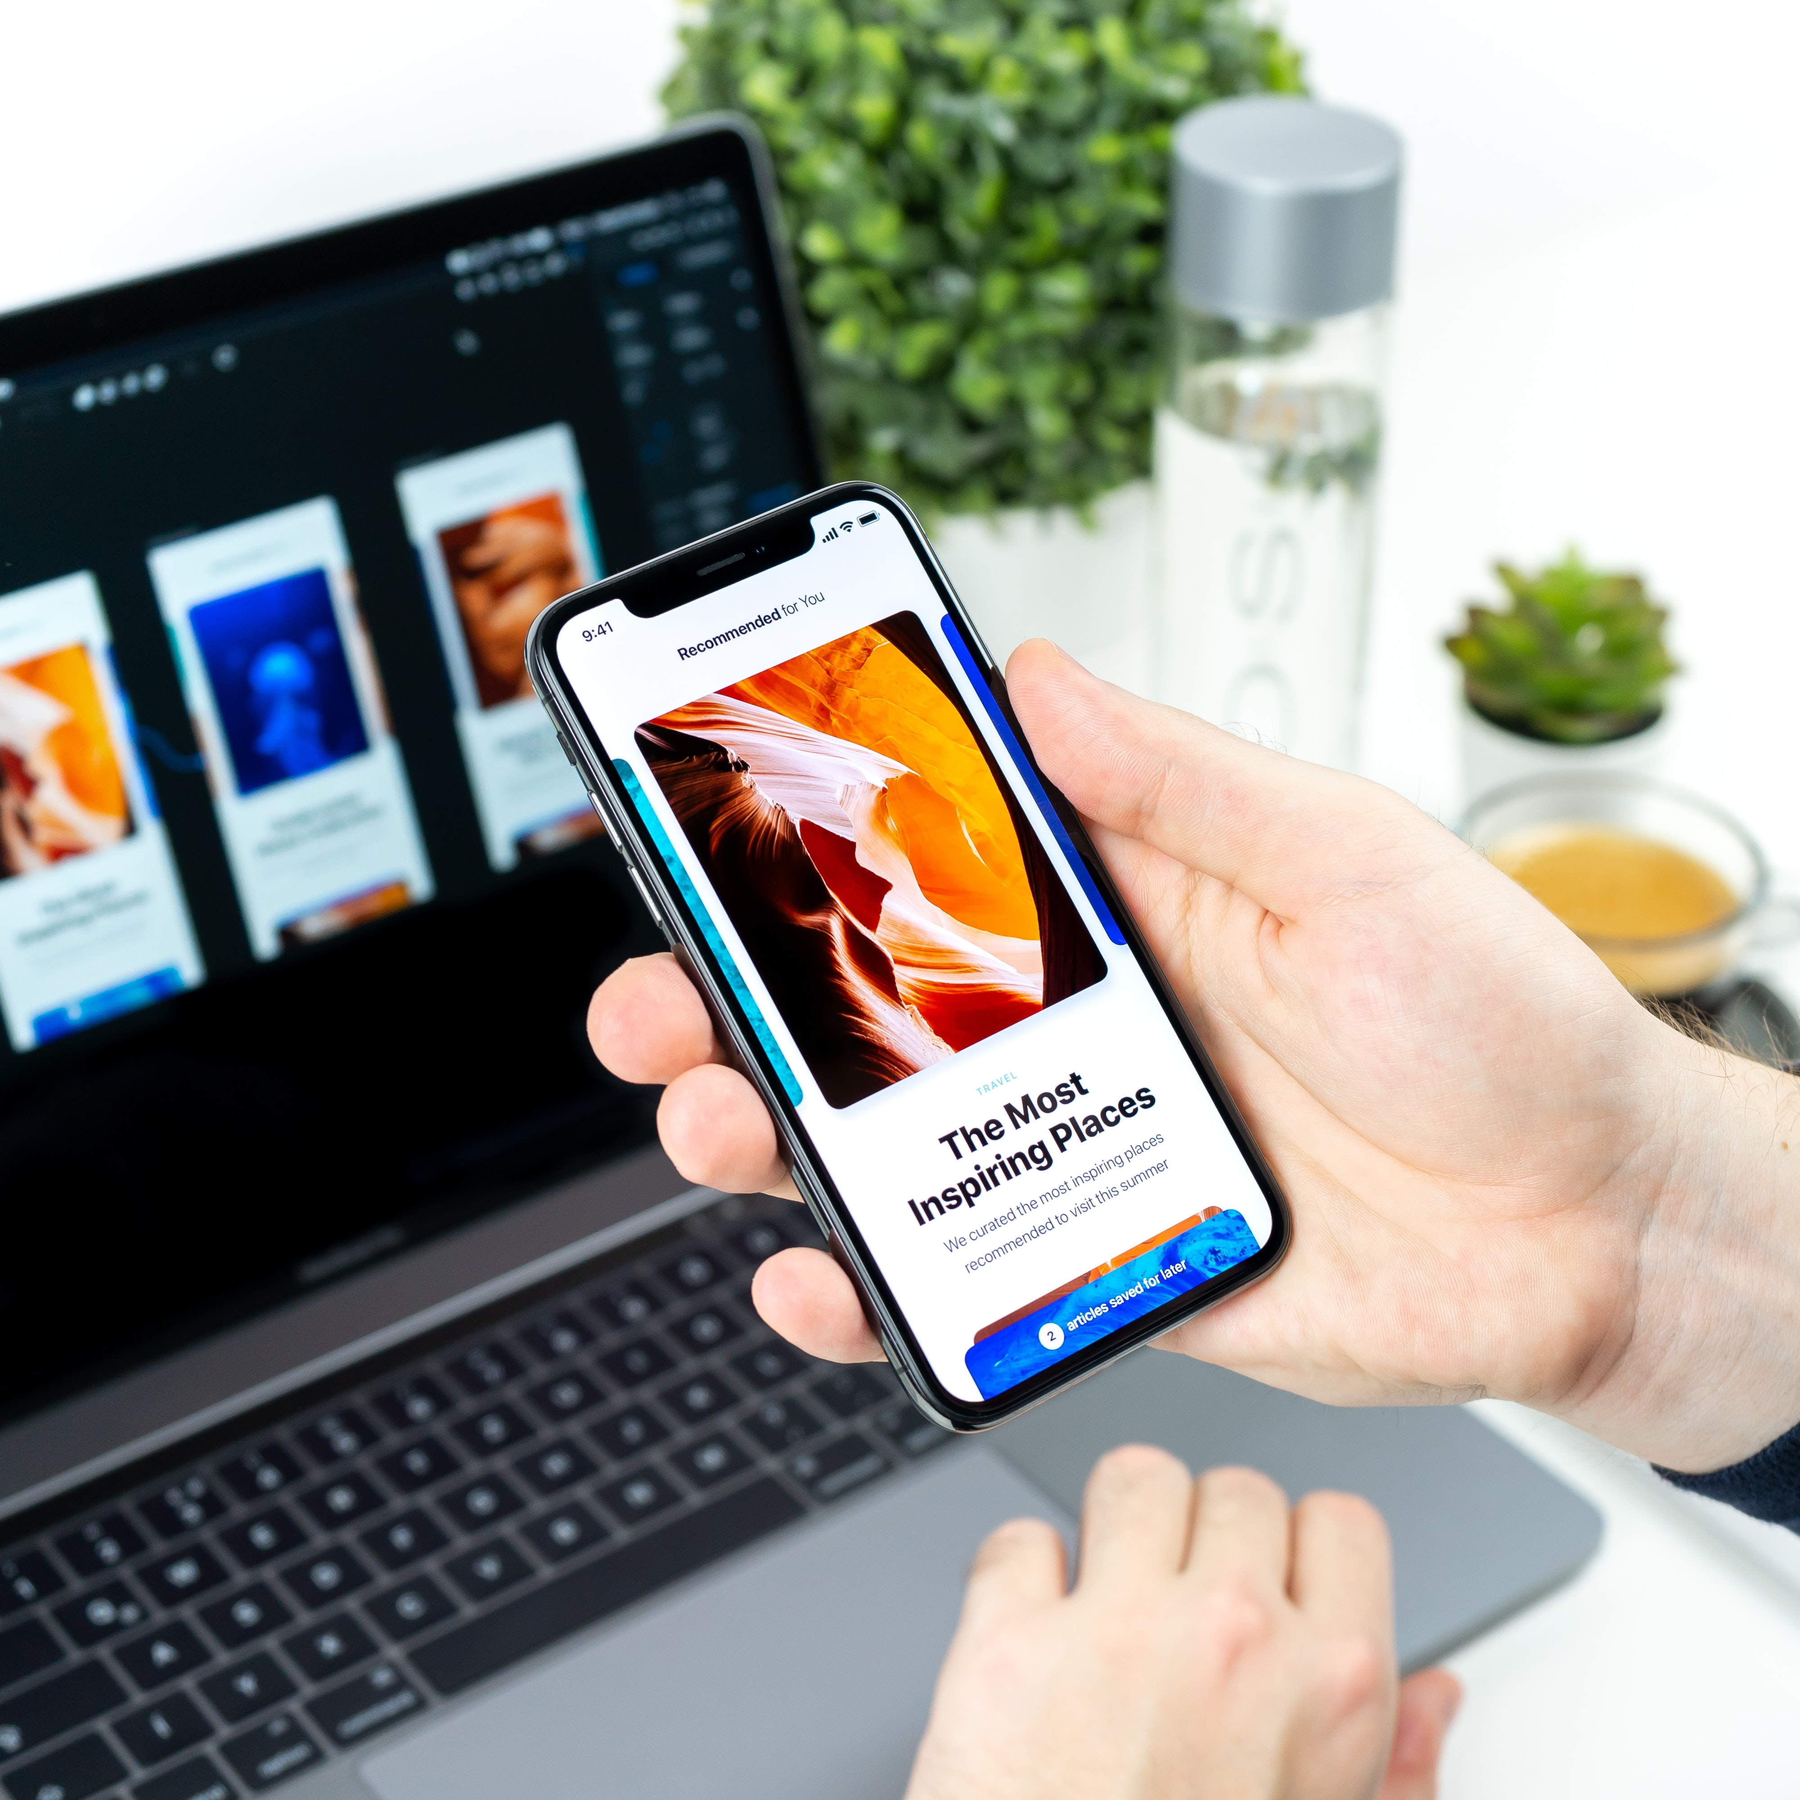
04
Website (Fornt End)

Slide 29
Tools Used for front-end
For Web Page Development
Html
CSS
Bootstrap
Flask

Slide 30
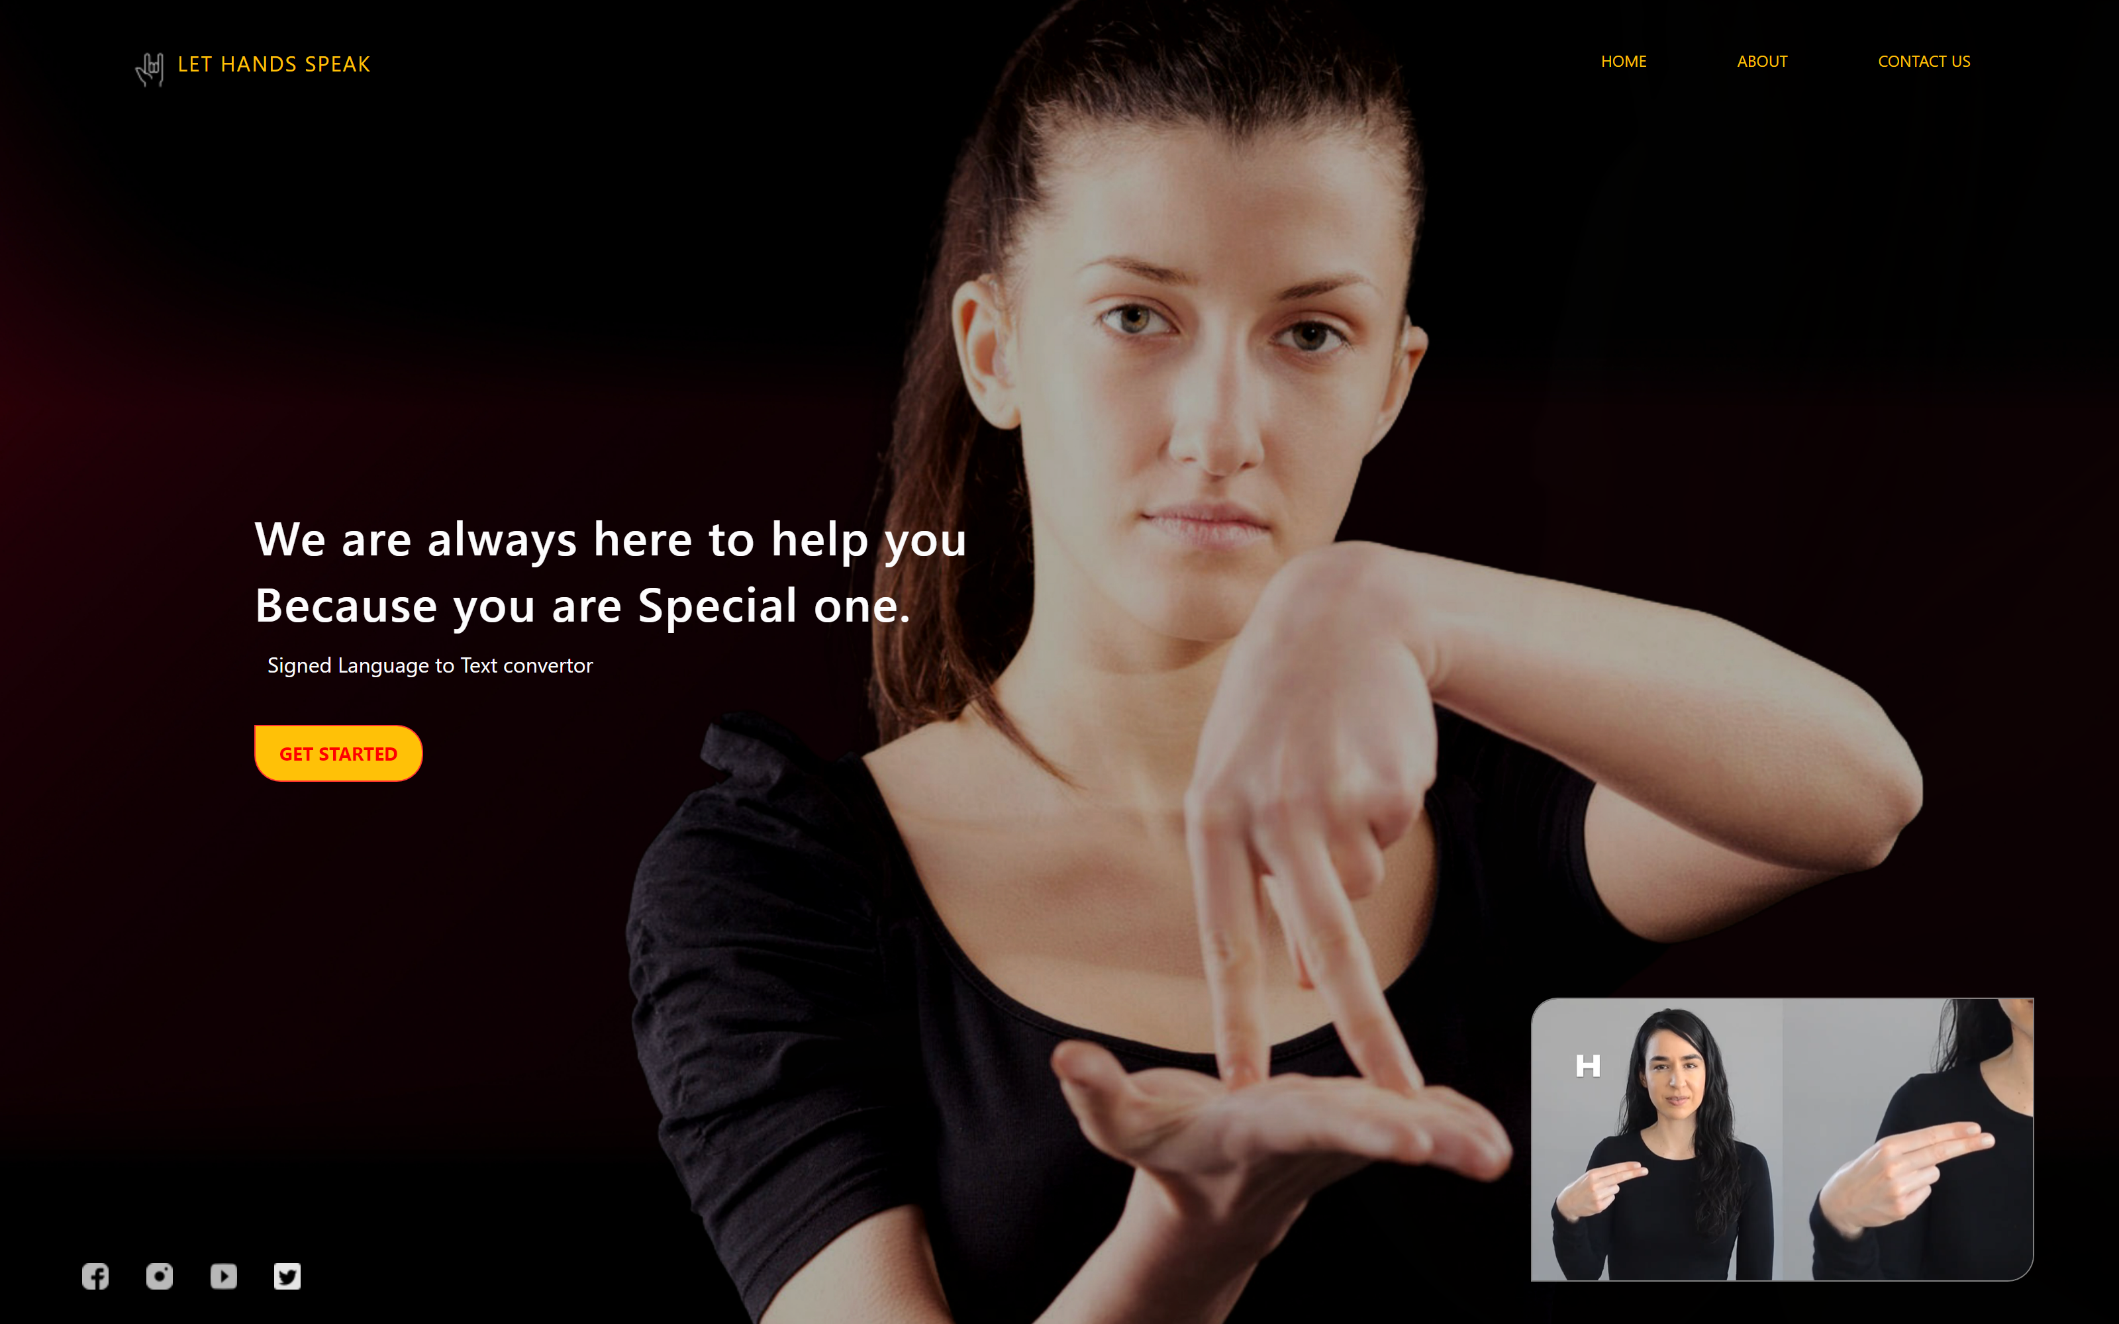
Let Hands Speak – Home page (Front End)

Slide 31
Index.html
Style.css
<html>
<head>
<title>Home | Let Hands Speak</title>
<link href="assets/css/style.css" rel="stylesheet" type="text/css" />
</head>
<body>
<div class="slider">
<div class="content">
<!-- Navigation Bar-->
<div class="navbar">
<a href="{{ url_for('index') }} " class="logo-text text-warning"><img
src="{{ url_for('static',filename='img/logo.png') }}" alt="logo" class="logo" />Let Hands Speak</a>
<ul><li><a href="{{ url_for('index') }}" class="text-warning">Home</a></li>
<li><a href="{{ url_for('about') }}" class="text-warning">About</a></li>
<li><a href="{{ url_for('contact') }}" class="text-warning">Contact us</a></li></ul>
</div> <!-- Conatent -->
<div class="containers">
<h1>We are always here to help you <br />Because you are Special one. </h1><p>Signed Language to Text convertor</p>
<br /><a href="{{ url_for('main') }}" class="btn btn-warning">Get Started</a>
</div> <!-- Footer-->
<footer>
<ul><li><a href="" target="_blank"><img src="{{ url_for('static',filename='img/icon-fb.png') }}" alt="logo" /></a></li>
<li><a href="" target="_blank"><img src="{{ url_for('static',filename='img/icon-insta.png') }}"alt="logo" /></a></li>
</footer>
<div class="video-box"><video controls autoplay muted width="380">
<source src="{{ url_for('static',filename='img/video1.mp4') }}" type="video/mp4" /></video></div>
</div></div>
</body>
</html>
HTML

Slide 32
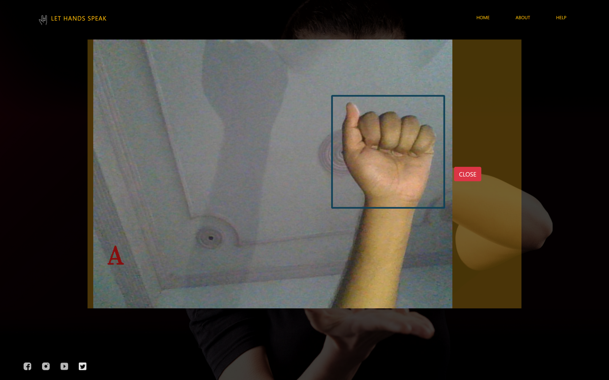
Let Hands Speak – Prediction page (Front End)

Slide 33
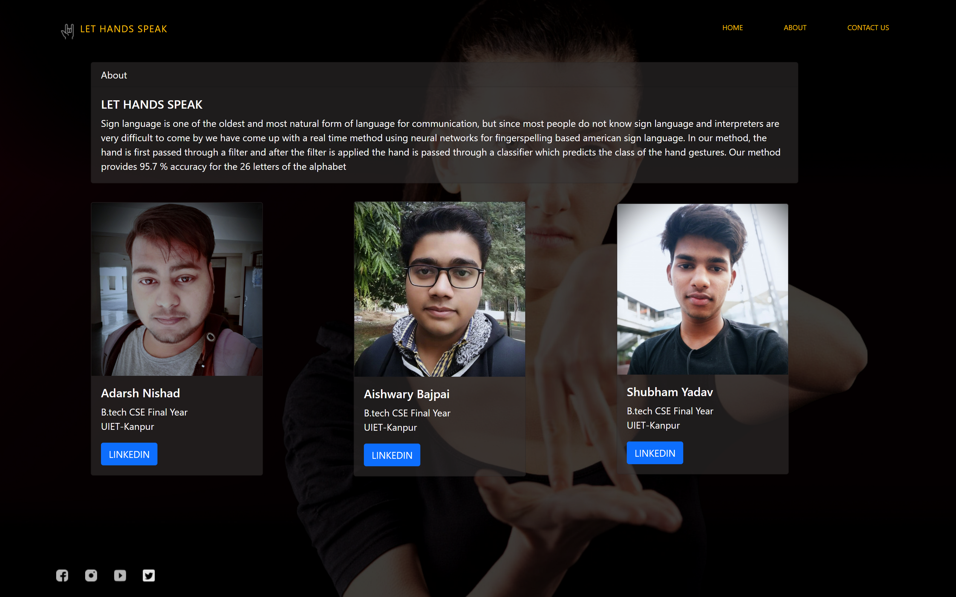
Let Hands Speak – About us (Front End)

Slide 34
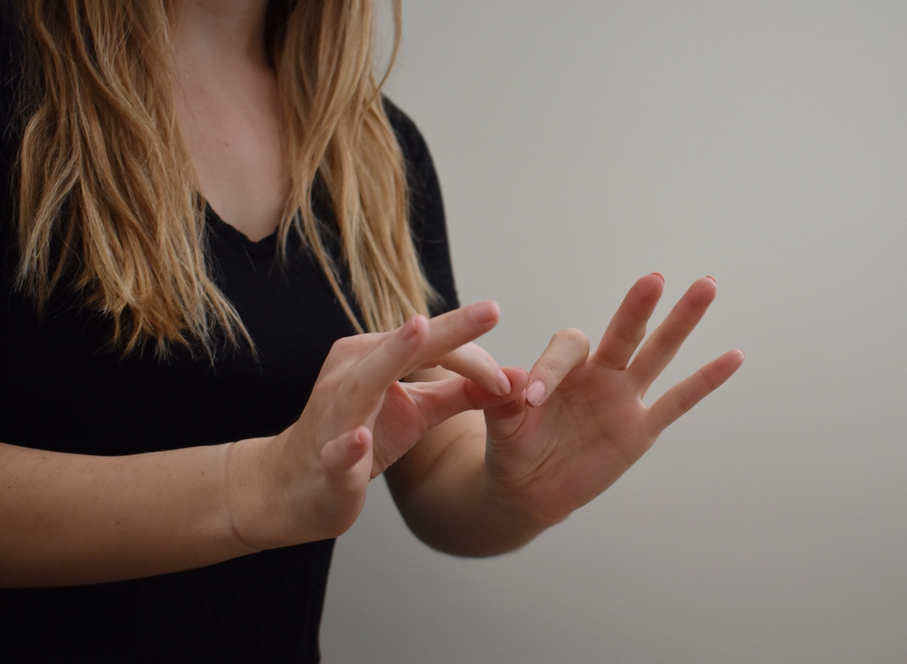
05
Classifying Gesture on Webpage (front-end)

Slide 35
Classifying Gesture on WebPage Using flask
Steps involved in taking video Frames for webpage:
Step1- Importing Flask, OpenCV & necessary libraries.
Step2- Initialize the flask app.
Step3- Capture Video using OpenCV.
Step4- Prediction on Flask App.
Step5- Define app route for default page of the web-app.
Step6- Define app route for the Video feed.
Step7- Starting the Flask Server .

Slide 36
App.py
Main.html
from flask import Flask, Response,render_template,Response
from keras.models import load_model
from keras.preprocessing import image
from PIL import Image
import cv2
import time
import numpy as np
app= Flask(__name__)
camera = cv2.VideoCapture(0)
classifier = load_model('Trained_model.h5’)
@app.route('/')
def index():
return render_template('index.html')
@app.route('/main')
def main():
return render_template('main.html’)
@app.route('/video')
def video():
return Response(generate_frames(),mimetype='multipart/x-mixed-replace; boundary=frame')
Python

Slide 37
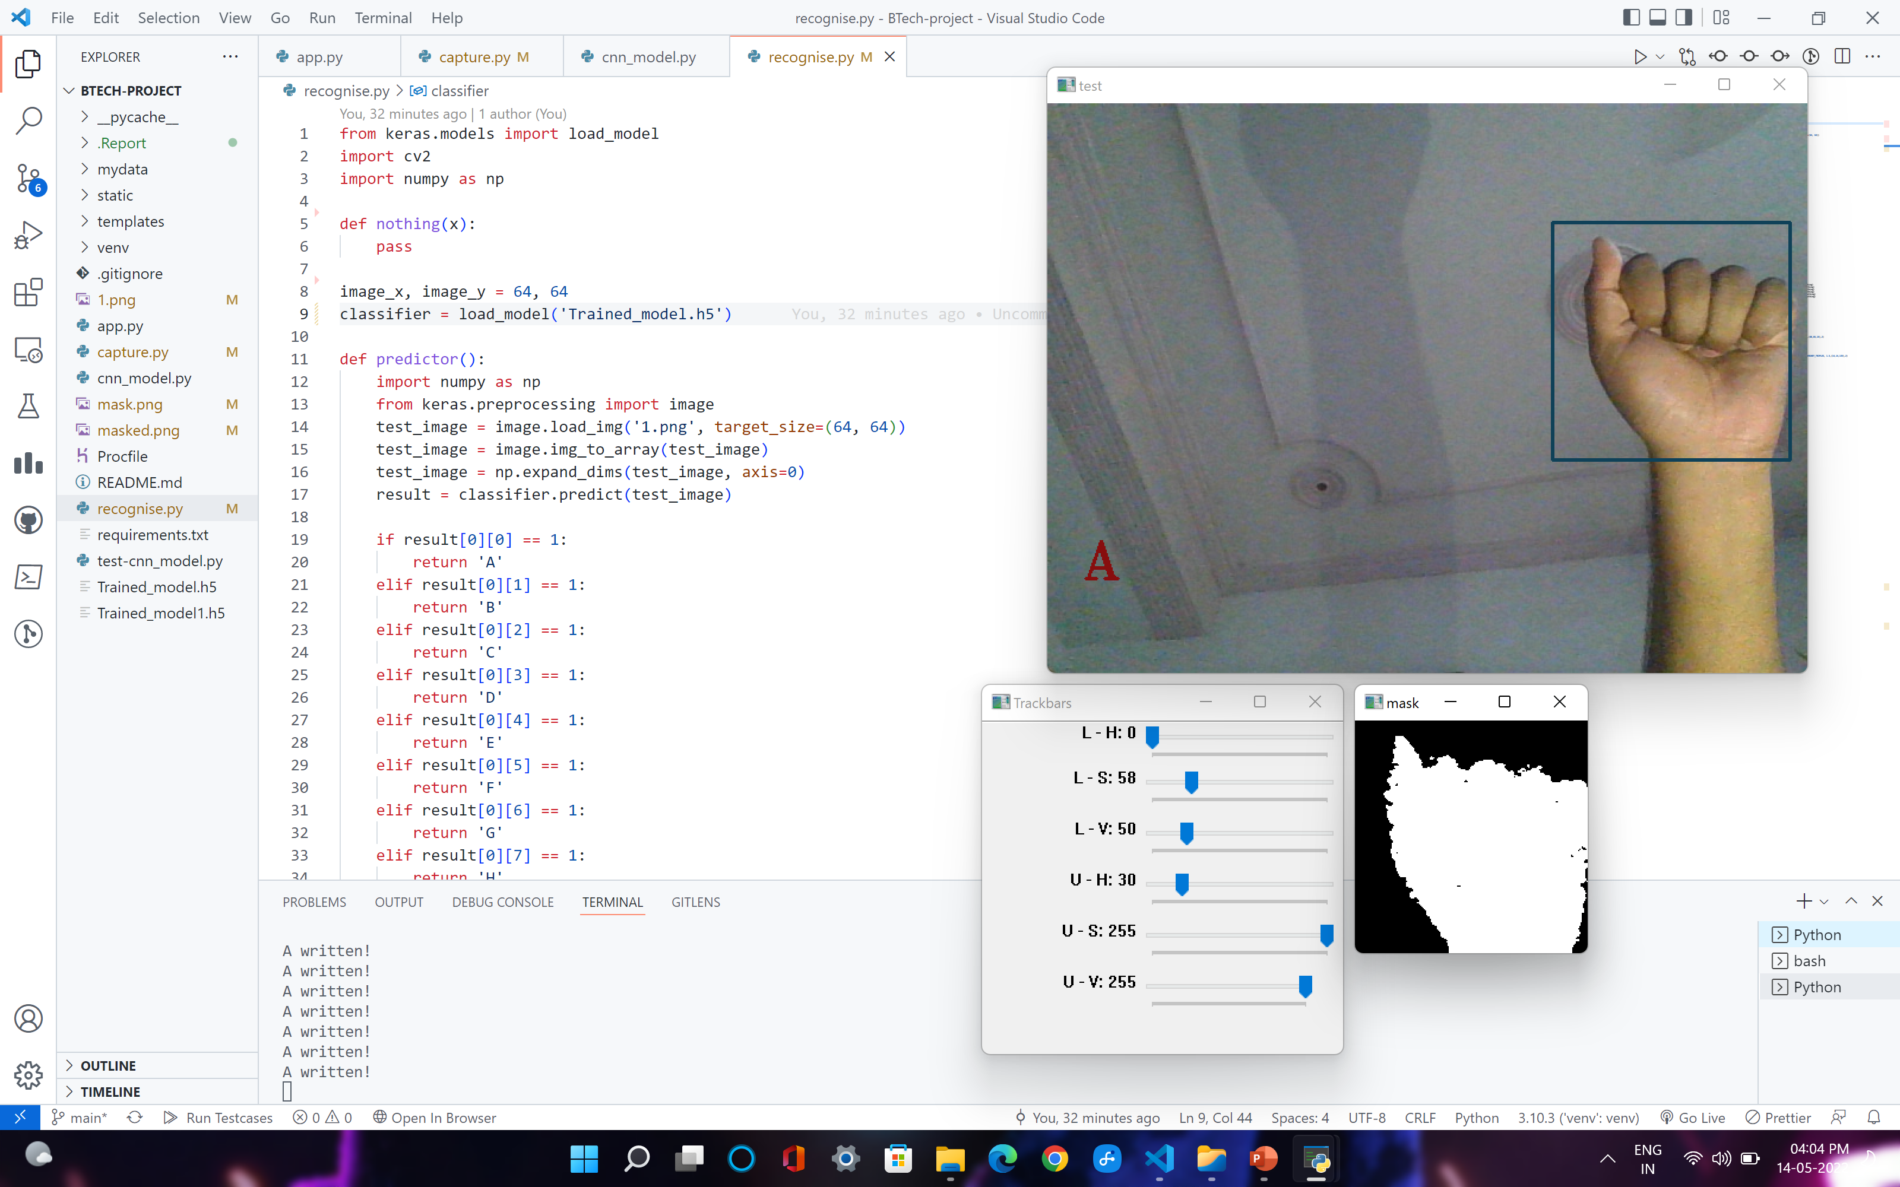
Prediction on Flask App
Step 1 :Reading image frames from video capturing device (web cam).
Step 2 : Crop the original image according to Region of interest.
Original Image

Slide 38
App.py
Main.html
def generate_frames():
img_text = 'None'
camera = cv2.VideoCapture(0)
print("on")
while True:
success,frame = camera.read()
if not success:
break
else:
frame = cv2.flip(frame, 1)
img = cv2.rectangle(frame,(425,100),(625,300),(88,65,15),2)
imcrop = img[102:298, 427:623]
cv2.putText(frame, img_text, (24, 400),cv2.FONT_HERSHEY_TRIPLEX, 1.5,(14,14,135),2)
cv2.imwrite('1.png',imcrop)
preprocessing(imcrop)
img_text = predictor()
ret,buffer = cv2.imencode('.png',frame)
frame = buffer.tobytes()
yield(b'--frame\r\n'b'Content-Type: image/png\r\n\r\n' + frame + b'\r\n')
Python

Slide 39
Prediction on Flask App
Step 3 : Preprocessing
Set Lower_HSV : 0,58,50 & Upper_HSV : 30,255,255 (best human skin color).
Convert the RGB cropped image into HSV image format.
Apply the Lower & Upper HSV value on HSV image to create Mask.
Apply Mask on cropped RGB image using Bitwise_AND to create masked image.
Mask
Masked Image

Slide 40
App.py
Main.html
def preprocessing(imcrop):
lower_blue = np.array([0,58,50])
upper_blue = np.array([30,255,255])
hsv = cv2.cvtColor(imcrop, cv2.COLOR_BGR2HSV)
mask = cv2.inRange(hsv, lower_blue, upper_blue)
result = cv2.bitwise_and(imcrop, imcrop, mask=mask)
cv2.imwrite('mask.png',mask)
cv2.imwrite('masked.png',result)
Python

Slide 41

Prediction on Flask App
Step 3 : Character Prediction
Set size of mask image to 64X64 px and named as test_image.
Convert the test_image into a numpy array using img_to_array function.
Now pass array to Modal using Modal.predict.
It will return the appropriate character value.
Mask(64X64)
Result

Slide 42
App.py
Main.html
def predictor():
test_image = image.load_img('mask.png', target_size=(64, 64))
test_image = image.img_to_array(test_image)
test_image = np.expand_dims(test_image, axis=0)
result = classifier.predict(test_image)
if result[0][0] == 1:
return 'A'
elif result[0][1] == 1:
return 'B'
elif result[0][2] == 1:
return 'C'
elif result[0][3] == 1:
.
.
.
elif result[0][25] == 1:
return 'Z'
else :
return 'None'
Python

Slide 43
Prediction on Flask App
Crop
Apply HSV To create mask
Cropped Image
HSV Trackbars
Original Image
A
Output
Prediction
Resulting Characters
Trained Modal.h5
Mask

Slide 44
Classifying Gesture on WebPage (Front-end)

Slide 45
App.py
Main.html
<html>
<head>
<title>Recognition | Let Hands Speak</title>
<link rel="stylesheet" type="text/css" href="{{ url_for('static',filename='css/style.css') }}">
</head>
<body>
<div class="bg">
<!-- Navigation Bar-->
<div class="navbar">
<a href="{{ url_for('index') }}" class="logo-text text-warning"><img
src="{{ url_for('static',filename='img/logo.png') }}" alt="logo" class="logo">Let Hands Speak</a>
<ul><li><a href="{{ url_for('index') }}" class="text-warning">Home</a></li>
<li><a href="{{ url_for('about') }}" class="text-warning">About</a></li></ul>
</div> <!-- Conatent -->
<div class="container" style="background-color:rgba(235, 171, 23, 0.3);" >
<img src=" {{ url_for('video') }}" width="85%" height="80%" />
<a href="{{ url_for('close') }}" class="btn btn-danger">Close</a>
</div>
</div>
</body>
</html>
HTML

Slide 46
06
Project Demo

Slide 47

THANKS End of Slide

